Slide 1
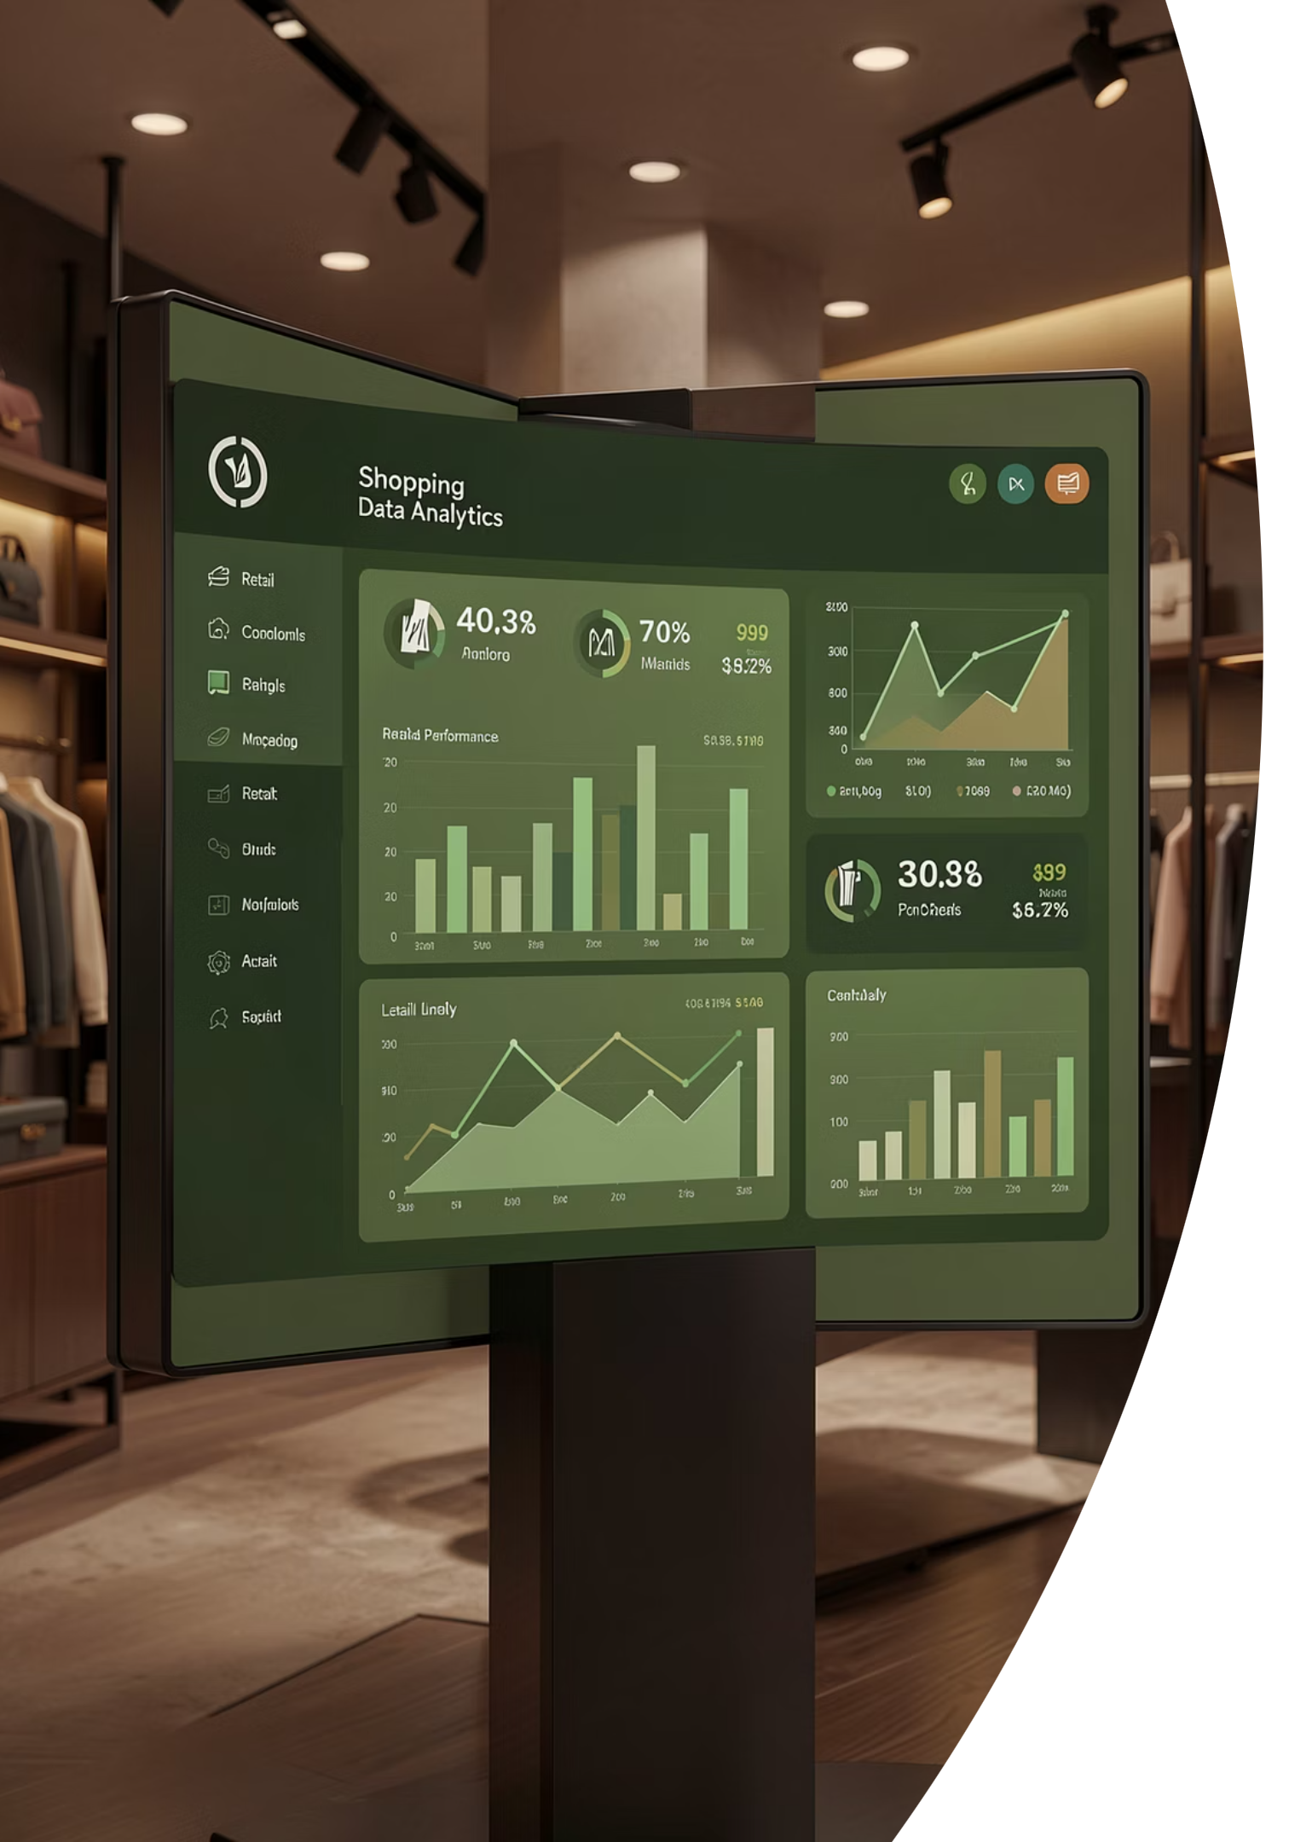
Customer Shopping Behavior Analysis
Uncovering spending patterns, customer segments, and product preferences from 3,900 transactions across multiple categories.

Slide 2
Dataset at a Glance
3,900
18
Transactions
Features
$59.76
3.75
Avg. Purchase
Avg. Rating
Demographics · Purchase details · Shipping · Discounts · Subscription status

Slide 3

Data Preparation in Python
01
Load & Explore
Imported with pandas; used df.info() and .describe()
02
Clean & Impute
37 missing review_rating values filled with category median
03
Feature Engineering
Created age_group and purchase_frequency_days columns
04
Load to SQL Server
Cleaned DataFrame exported to SQL Server for structured analysis

Slide 4
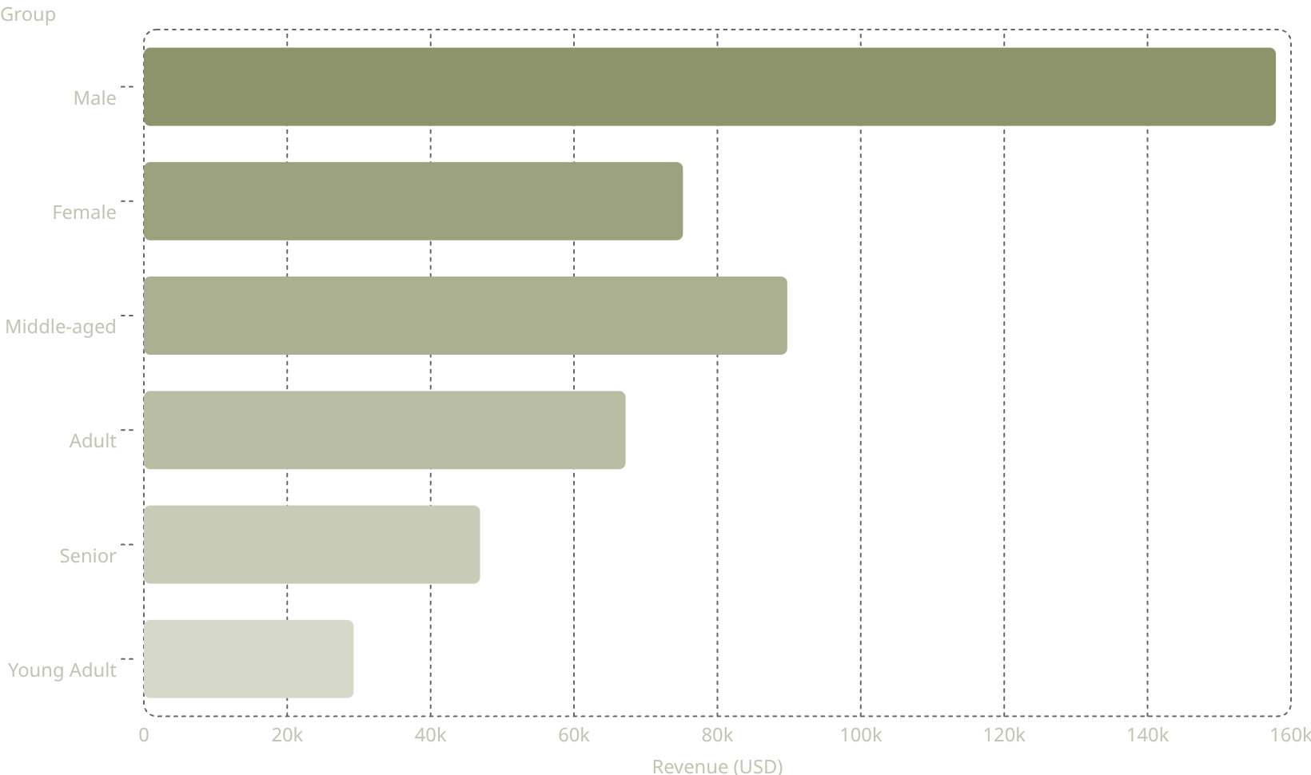
Revenue Insights
Key Findings
Male customers generate 2× more revenue than female
Middle-aged segment leads all age groups at $89,741
Young Adults contribute the least at $29,258

Slide 5


Customer Segmentation
Segments by Purchase History
Loyal (3,116) — majority of the base
Returning (701) — re-engaged buyers
New (83) — acquisition opportunity
Loyal·79.9%
·79.9%
·
Returning·17.97%
·17.97%
·
New·2.13%
·2.13%
·
958 repeat buyers (>5 purchases) hold active subscriptions

Slide 6
Subscriptions & Discounts
Subscribers
Discount-Heavy Products
High-Spend Discount Users
27% subscribed · 73% not subscribed
Hat 50% · Coat 49% · Sneakers 49% · Sweater 48% · Pants 47%
Many discount users still spend above average — discounts don't erode value
Avg. spend equal at $59 for both groups

Slide 7
Top Products & Categories
Top-Rated Products
Best Sellers by Category
Product
Avg Rating
Category
#1 Product
Gloves
3.86
Clothing
Blouse / Pants (171)
Sandals
3.84
Accessories
Jewelry (171)
Boots
3.82
Outerwear
Jacket (163)
Hat
3.80
Footwear
Sandals (160)
Skirt
3.78

Slide 8
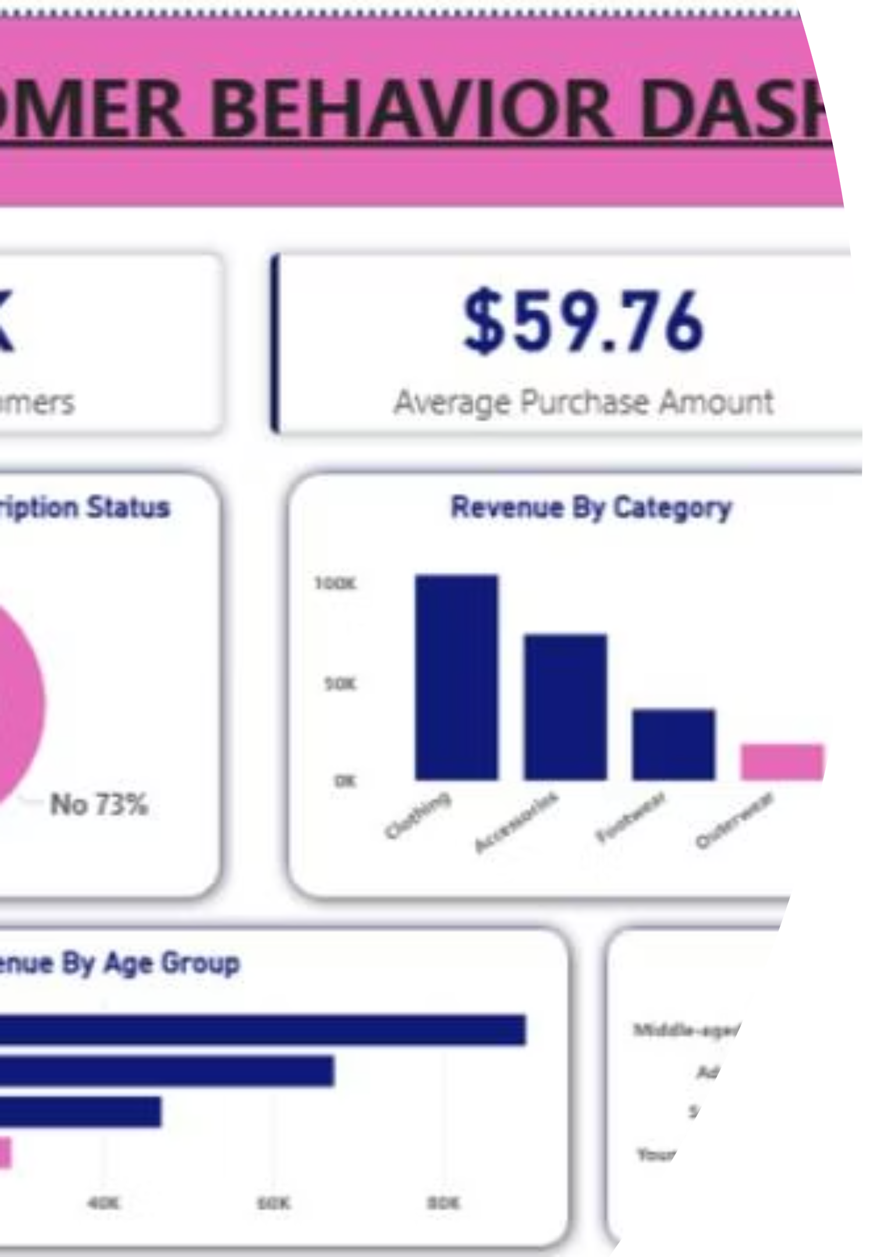

Power BI Dashboard
Interactive Filters
Subscription, Gender, Category, Shipping Type
Revenue & Sales
By category and age group
Subscription Split
27% Yes · 73% No

Slide 9
Business Recommendations
Boost Subscriptions
Loyalty Programs
Review Discount Policy
Promote exclusive benefits to convert the 73% non-subscribers
Reward repeat buyers to grow the Loyal segment
Balance sales boosts with margin control on high-discount items
Targeted Marketing
Product Positioning
Focus on middle-aged, high-revenue segments and express-shipping users
Highlight top-rated and best-selling products in campaigns

